Slide 1
Non Verbal Matrices
An exploration of non verbal matrices and their applications
A.S.M. Kamrul Islam
Lecturer, Green University of Bangladesh

Slide 2
Types of Learning Domains
Cognitive
Psychomotor
Affective

Slide 3

Types of Non Verbal Communication
Facial expressions
Gestures and body language
Posture and stance
Eye contact
Voice tone and inflection

Slide 4
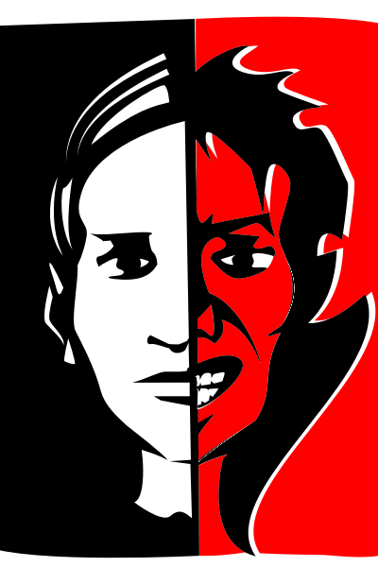
Facial Expressions
They convey emotions and can greatly impact how a message is perceived.
Facial expressions are responsible for a huge proportion of nonverbal communication.

Slide 5
Gesture and Body Language
Interpretation of body language
Depends on context
They can be common or culturally specific.
They are deliberate movements and signals used to communicate meaning.

Slide 6
Posture and Stance
Mood and Mental Well-being
Increased Confidence
More Energy
Power Dynamics

Slide 7
Eye Contact
Significance of eye contact
Using eye contact to build rapport
Cultural variations in eye contact

Slide 8
Voice Tone and Inflection
Communication Clarity
Emotional Expression
Engagement and Attention
Conflict Resolution and Leadership

Slide 9

Applications of Non Verbal Matrices
Business and professional settings
Public speaking and presentations
Interpersonal relationships
Negotiation and conflict resolution

Slide 10

Queries?

